Slide 1
Artificial Neural Network
KDM Spring 2020

Slide 2
Biological Inspirations
Humans perform complex tasks like vision, motor control, or language understanding very well. One way to build intelligent machines is to try to imitate the (organizational principles of) human brain.

Slide 3
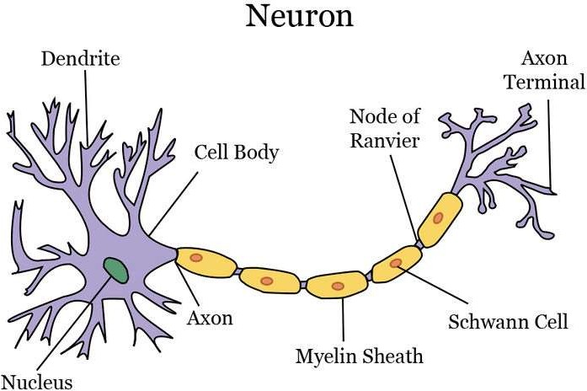
What is a Neuron?
Source: Wikipedia

Slide 4
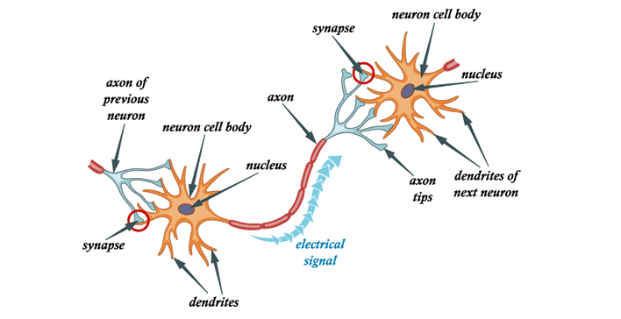
What is a Neural Network?
Source: Wikipedia

Slide 5
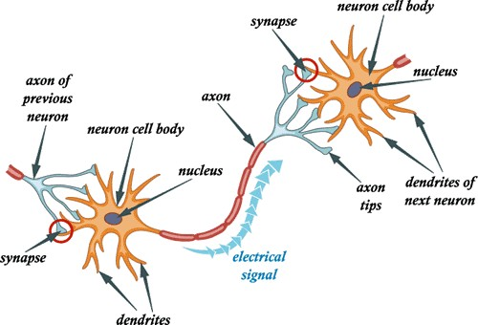
Why Neural Networks?
The human brain can be considered to be one of the best processors. (Estimated to contain ~1011 neurons.)
Studies show that our brain can process the equivalent of ~20Mb/sec just through the optical nerves
If we can copy this design, maybe we can solve the “hard for a computer – easy for humans” problems
Sentiment analysis
Reading emotions
Recognizing images
Speech recognition
Facial identification
Driving a vehicle
Disease diagnosis
Source: SlideShare

Slide 6
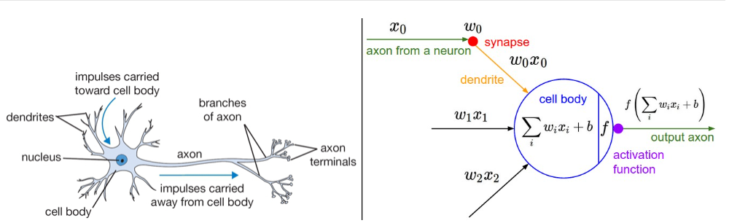
Artificial Neural Network
Source: SuperDataScience

Slide 7

ANN

Slide 8
Weights and Bias in ANN
For Neural network:
output = sum (weights * inputs) + bias
The weight shows the effectiveness of a particular input. More the weight of input, more it will have impact on network
Bias is like the intercept added in a linear equation. It is an additional parameter in the Neural Network which is used to adjust the output along with the weighted sum of the inputs to the neuron. Therefore Bias is a constant which helps the model in a way that it can fit best for the given data

Slide 9
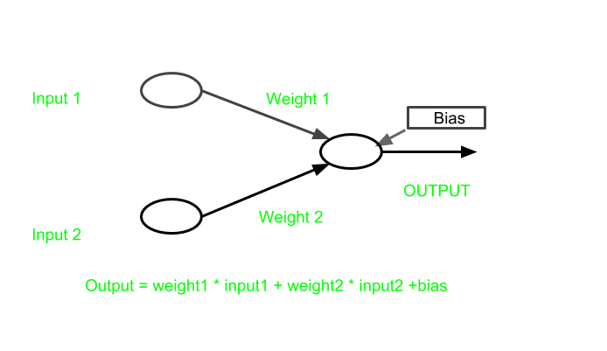
Weights and Bias in ANN
In this figure :
y = mx + c
Where m = weight and c = bias

Slide 10
Different types of ANN
Feedforward (Convolutional, Autoencoder, Probabilistic and Time delay)
Recurrent Neural Network(LSTM)
Regulatory feedback
Radial basis function (RBF)
Modular
Source: Wikipedia

Slide 11
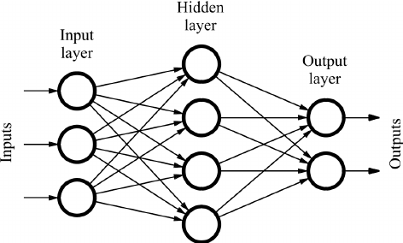
Feedforward NN
The feedforward neural network was the first and simplest type
In this network, the information moves in only one direction, forward, from the input nodes, through the hidden nodes (if any) and to the output nodes
There are no cycles or loops in the network
Source: Wikipedia

Slide 12
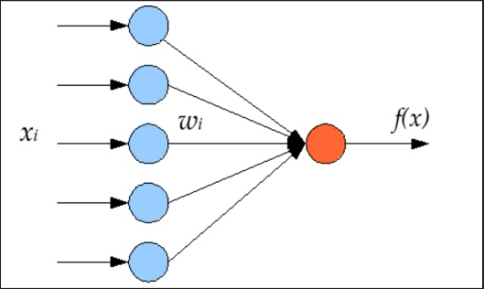
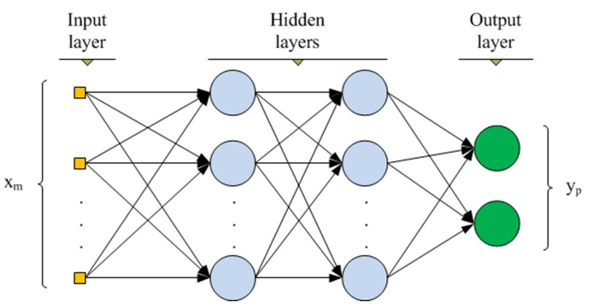
Types of FNN
Single Layer Perceptron Multi Layer Perceptron
Perceptron: In machine learning, the perceptron is an algorithm for supervised learning
Source: Wikipedia

Slide 13
Feed forward neural network
_{a}(2) _{a}(3)
_{W}(1) _{W}(2) _{W}(3)
_{a}(4)
x₁
ŷ
x₂
+1
+1
+1
_{l} (1)
input
_{l} (2)
hidden 1
_{l} (3)
hidden 2
_{l} (4)
output

Slide 14
_{a}(2)
_{a}(3)
_{a}(4)
_{W}(1)
_{W}(2)
_{W}(3)
σ
σ
x₁
SM
ŷ
σ
σ
x₂
SM
σ
σ
+1
SM
+1
+1
x_{i}: input value
σ:
sigmoid (logistic) function
+1:
_{a}(l):
bias (constant) unit
activation vector for layer l
_{W}(l):
_{z}(l):
weight matrix for layer l
input into layer l
ŷ:
output vector
SM: Softmax function

Slide 15
Layer 1
_{a}(2)
_{a}(3)
_{a}(4)
_{W}(1)
_{W}(2)
_{W}(3)
σ
σ
x₁
SM
ŷ
σ
σ
x₂
SM
σ
σ
+1
SM
+1
+1
x_{i}: input value
σ:
sigmoid (logistic) function
+1:
_{a}(l):
bias (constant) unit
activation vector for layer l
_{W}(l):
_{z}(l):
weight matrix for layer l
input into layer l
ŷ:
output vector
SM: Softmax function

Slide 16
Layer 2
_{a}(2)
_{a}(3)
_{a}(4)
_{W}(1)
_{W}(2)
_{W}(3)
σ
σ
x₁
SM
ŷ
σ
σ
x₂
SM
σ
σ
+1
SM
+1
+1
x_{i}: input value
σ:
sigmoid (logistic) function
+1:
_{a}(l):
bias (constant) unit
activation vector for layer l
_{W}(l):
_{z}(l):
weight matrix for layer l
input into layer l
ŷ:
output vector
SM: Softmax function

Slide 17
Layer 3
_{a}(2)
_{a}(3)
_{a}(4)
_{W}(1)
_{W}(2)
_{W}(3)
σ
σ
x₁
SM
ŷ
σ
σ
x₂
SM
σ
σ
+1
SM
+1
+1
x_{i}: input value
σ:
sigmoid (logistic) function
+1:
_{a}(l):
bias (constant) unit
activation vector for layer l
_{W}(l):
_{z}(l):
weight matrix for layer l
input into layer l
ŷ:
output vector
SM: Softmax function

Slide 18
Layer 4
_{a}(2)
_{a}(3)
_{a}(4)
_{W}(1)
_{W}(2)
_{W}(3)
σ
σ
x₁
SM
ŷ
σ
σ
x₂
SM
σ
σ
+1
SM
+1
+1
x_{i}: input value
σ:
sigmoid (logistic) function
+1:
_{a}(l):
bias (constant) unit
activation vector for layer l
_{W}(l):
_{z}(l):
weight matrix for layer l
input into layer l
ŷ:
output vector
SM: Softmax function

Slide 19
_{a}(2)
_{a}(3)
_{a}(4)
_{W}(1)
_{W}(2)
_{W}(3)
σ
σ
x₁
SM
ŷ
σ
σ
x₂
SM
σ
σ
+1
SM
+1
+1
Biases (constant units)
x_{i}: input value
σ:
sigmoid (logistic) function
+1:
_{a}(l):
bias (constant) unit
activation vector for layer l
_{W}(l):
_{z}(l):
weight matrix for layer l
input into layer l
ŷ:
output vector
SM: Softmax function

Slide 20
_{a}(2)
_{a}(3)
_{a}(4)
Input
_{W}(1)
_{W}(2)
_{W}(3)
σ
σ
x₁
SM
ŷ
σ
σ
x₂
SM
σ
σ
+1
SM
+1
+1
x_{i}: input value
σ:
sigmoid (logistic) function
+1:
_{a}(l):
bias (constant) unit
activation vector for layer l
_{W}(l):
_{z}(l):
weight matrix for layer l
input into layer l
ŷ:
output vector
SM: Softmax function

Slide 21
Weight matrices
_{a}(2)
_{a}(3)
_{a}(4)
_{W}(1)
_{W}(2)
_{W}(3)
σ
σ
x₁
SM
ŷ
σ
σ
x₂
SM
σ
σ
+1
SM
+1
+1
x_{i}: input value
σ:
sigmoid (logistic) function
+1:
_{a}(l):
bias (constant) unit
activation vector for layer l
_{W}(l):
_{z}(l):
weight matrix for layer l
input into layer l
ŷ:
output vector
SM: Softmax function

Slide 22
_{z}(l) _{= W}(l-1)_{a}(l-1) _{+ b}(l-1)
Layer inputs, z^{(l)}
_{a}(2)
_{a}(3)
_{a}(4)
_{W}(1)
_{W}(2)
_{W}(3)
σ
σ
x₁
SM
ŷ
σ
σ
x₂
SM
σ
σ
+1
SM
+1
+1
x_{i}: input value
σ:
sigmoid (logistic) function
+1:
_{a}(l):
bias (constant) unit
activation vector for layer l
_{W}(l):
_{z}(l):
weight matrix for layer l
input into layer l
ŷ:
output vector
SM: Softmax function

Slide 23
Activation vectors
_{a}(2)
_{a}(3)
_{a}(4)
_{W}(1)
_{W}(2)
_{W}(3)
σ
σ
x₁
SM
ŷ
σ
σ
x₂
SM
σ
σ
+1
SM
+1
+1
x_{i}: input value
σ:
sigmoid (logistic) function
+1:
_{a}(l):
bias (constant) unit
activation vector for layer l
_{W}(l):
_{z}(l):
weight matrix for layer l
input into layer l
ŷ:
output vector
SM: Softmax function

Slide 24
Sigmoid activation function
_{a}(2) _{a}(3)
_{W}(1) _{W}(2)
σ σ
_{a}(4)
_{W}(3)
x₁
SM
ŷ
σ
σ
x₂
SM
σ
σ
+1
SM
+1
+1
x_{i}: input value
σ:
sigmoid (logistic) function
+1:
_{a}(l):
bias (constant) unit
activation vector for layer l
_{W}(l):
_{z}(l):
weight matrix for layer l
input into layer l
ŷ:
output vector
SM: Softmax function

Slide 25
Softmax activation function
_{a}(3) _{a}(4)
_{a}(2)
_{W}(1)
_{W}(2)
_{W}(3)
σ
σ
x₁
SM
ŷ
σ
σ
x₂
SM
σ
σ
+1
SM
+1
+1
x_{i}: input value
σ:
sigmoid (logistic) function
+1:
_{a}(l):
bias (constant) unit
activation vector for layer l
_{W}(l):
_{z}(l):
weight matrix for layer l
input into layer l
ŷ:
output vector
SM: Softmax function

Slide 26
_{a}(2)
_{a}(3)
_{a}(4)
Output
_{W}(1)
_{W}(2)
_{W}(3)
σ
σ
x₁
SM
ŷ
σ
σ
x₂
SM
σ
σ
+1
SM
+1
+1
x_{i}: input value
σ:
sigmoid (logistic) function
+1:
_{a}(l):
bias (constant) unit
activation vector for layer l
_{W}(l):
_{z}(l):
weight matrix for layer l
input into layer l
ŷ:
output vector
SM: Softmax function

Slide 27
Forward Propagation
_{a}(2)
_{a}(3)
_{a}(4)
_{W}(1)
_{W}(2)
_{W}(3)
x₁
x₂
Input vector is passed into the network

Slide 28
Forward Propagation
_{a}(2)
_{a}(3)
_{a}(4)
_{W}(1)
_{W}(2)
_{W}(3)
x₁
x₂
+1
_{z}(2) _{= W}(1)_{x + b}(1)
Input is multiplied with W⁽¹⁾ weight matrix and added with layer 1 biases to calculate z⁽²⁾

Slide 29
Forward Propagation
_{a}(2)
_{a}(3)
_{a}(4)
_{W}(1)
_{W}(2)
_{W}(3)
σ
x₁
σ
x₂
σ
+1
_{a}(2) _{= σ(z}(2)₎
Activation value for the second layer is calculated by passing z⁽²⁾ into some function. In this case, the sigmoid function.

Slide 30
Forward Propagation
_{a}(2)
_{a}(3)
_{a}(4)
_{W}(1)
_{W}(2)
_{W}(3)
σ
x₁
σ
x₂
σ
+1
+1
_{z}(3) _{= W}(2)_{a}(2) _{+ b}(2)
z⁽³⁾ is calculated by multiplying a⁽²⁾ vector with W⁽²⁾ weight matrix and adding layer 2 biases

Slide 31
Forward Propagation
_{a}(2)
_{a}(3)
_{W}(1)
_{W}(2)
_{W}(3)
σ
σ
x₁
σ
σ
x₂
σ
σ
+1
+1
_{a}(3) _{= σ(z}(3)₎
Similar to previous layer, a⁽³⁾ is calculated by passing z⁽³⁾ into the sigmoid function

Slide 32
Forward Propagation
_{a}(2)
_{a}(3)
_{a}(4)
_{W}(1)
_{W}(2)
_{W}(3)
σ
σ
x₁
σ
σ
x₂
σ
σ
+1
+1
+1
_{z}(4) _{= W}(3)_{a}(3) _{+ b}(3)
z⁽⁴⁾ is calculated by multiplying a⁽³⁾ vector with W⁽³⁾ weight matrix and adding layer 3 biases

Slide 33
Forward Propagation
_{a}(2)
_{a}(3)
_{a}(4)
_{W}(1)
_{W}(2)
_{W}(3)
σ
σ
x₁
SM
σ
σ
x₂
SM
σ
σ
+1
SM
+1
+1
a⁽⁴⁾ = SM(z⁽⁴⁾)
For the final layer, we calculate a⁽⁴⁾ by passing z⁽⁴⁾ into the Softmax function

Slide 34
Forward Propagation
_{a}(2)
_{a}(3)
_{a}(4)
_{W}(1)
_{W}(2)
_{W}(3)
σ
σ
x₁
SM
ŷ
σ
σ
x₂
SM
σ
σ
+1
SM
+1
+1
We then make our prediction based on the final layer’s output

Slide 35
_{z}(2) _{= W}(1)_{x + b}(1)
_{a}(2) _{= σ(z}(2)₎
_{z}(3) _{= W}(2)_{a}(2) _{+ b}(2)
_{a}(3) _{= σ(z}(3)₎
_{z}(4) _{= W}(3)_{a}(3) _{+ b}(3)
a⁽⁴⁾ = ŷ = SM(z⁽⁴⁾)
Page of Math

Slide 36
Types of Feed Forward Networks
Autoencoders

Slide 37
Autoencoders
Autoencoders are a specific type of feedforward neural networks where the input is the same as the output.
They compress the input into a lower-dimensional code and then reconstruct the output from this representation.
The code is a compact “summary” or “compression” of the input, also called the latent-space representation.

Slide 38
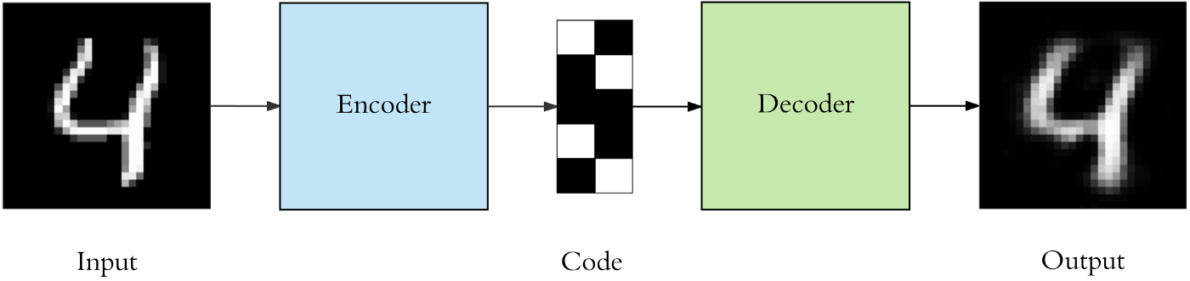
Autoencoder
To build an autoencoder we need 3 things: an encoding method, decoding method, and a loss function to compare the output with the target.
An autoencoder consists of 3 components: encoder, code and decoder. The encoder compresses the input and produces the code, the decoder then reconstructs the input only using this code.

Slide 39
Autoencoder
Autoencoders are mainly a dimensionality reduction (or compression) algorithm with a couple of important properties:
Data-specific: Autoencoders are only able to meaningfully compress data similar to what they have been trained on. So we can’t expect an autoencoder trained on handwritten digits to compress landscape photos.
Lossy: The output of the autoencoder will not be exactly the same as the input, it will be a close but degraded representation. If you want lossless compression they are not the way to go.
Unsupervised: Autoencoders are considered an unsupervised learning technique since they don’t need explicit labels to train on. But to be more precise they are self-supervised because they generate their own labels from the training data.

Slide 40
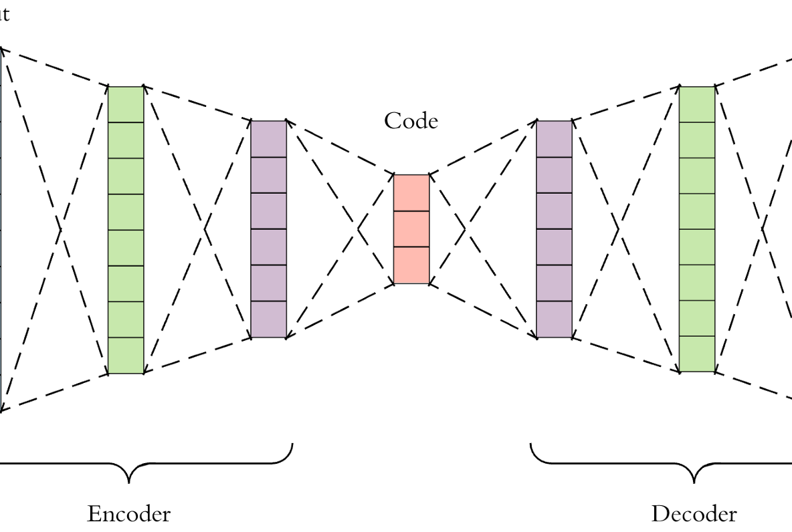
Autoencoder architecture

Slide 41
Applications of Autoencoders
Dimensionality Reduction
Image Compression
Image Denoising
Feature Extraction
Image generation
Sequence to sequence prediction
Recommendation system

Slide 42
Types of Feed Forward Networks
Convolutional Neural Network (CNN)

Slide 43

Convolutional Neural Network (CNN)
Convolutional Neural Networks (CNN) are biologically-inspired variants of Multilayer perceptron(MLPs)
Easiest way to understand a convolution is by thinking of it as a sliding window function applied to a matrix
Source: Wikipedia
Convolution with 3×3 Filter

Slide 44
Convolutional Neural Network (CNN)
There are four main operations in the CNN
Convolution
Non-Linearity
Pooling or Sub Sampling
Classification (Fully Connected Layer)
Source: https://ujjwalkarn.me/2016/08/11/intuitive-explanation-convnets/

Slide 45
Convolution
The primary purpose of Convolution is to extract features from the input image/text
Convolution preserves the spatial relationship between pixels by learning image features using small squares of input data
Convolution preserves the semantic relationship between words by learning text features using small part of input data
Source: https://ujjwalkarn.me/2016/08/11/intuitive-explanation-convnets/

Slide 46
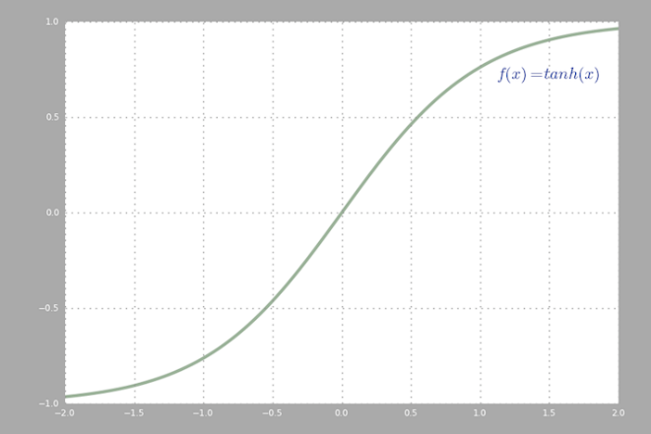
Non Linearity
Input to networks are usually linear transformation (input * weight), but real world and problems are non-linear
To make the incoming data nonlinear, we use nonlinear mapping called activation function.
Source: https://ujjwalkarn.me/2016/08/11/intuitive-explanation-convnets/

Slide 47
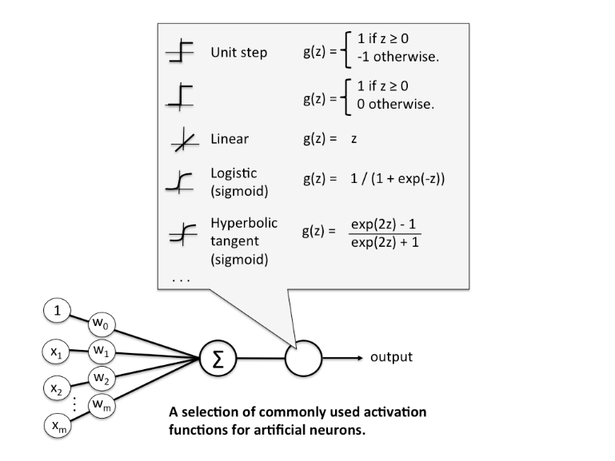
What is activation function
In computational networks, the activation function of a node defines the output of that node given an input or set of inputs
Source: Wikipedia

Slide 48
Why activation function
The purpose of the activation function is to introduce non-linearity into the network in turn, this allows you to model a response variable that varies non-linearly with its explanatory variables
Non-linear means that the output cannot be reproduced from a linear combination of the inputs
Source: Wikipedia

Slide 49
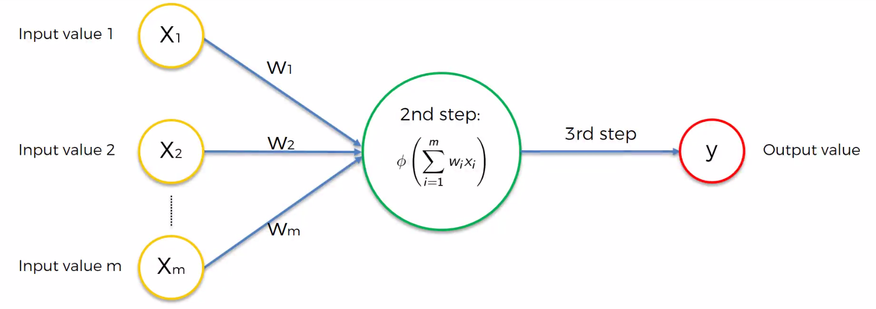
Activation function
Source: SuperDataScience

Slide 50
Different types of activation functions
Threshold Function/Step Function
Sigmoid
Rectifier
Hyperbolic Tangent(tanh)
Source: SuperDataScience

Slide 51
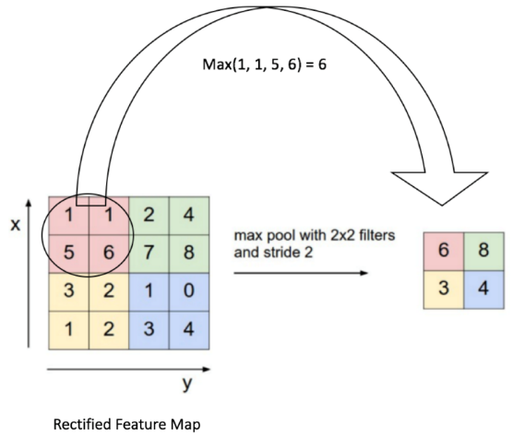
Pooling or Sub Sampling
Pooling (also called subsampling or downsampling) reduces the dimensionality of each feature map but retains the most important information
Pooling can be of different types: Max, Average, Sum etc.
Source: https://ujjwalkarn.me/2016/08/11/intuitive-explanation-convnets/

Slide 52
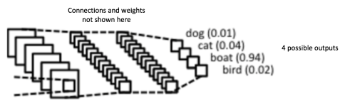
Classification (Fully Connected Layer)
The Fully Connected layer is a traditional Multi Layer Perceptron that uses a any(e.g. softmax) activation function in the output layer
Source: https://ujjwalkarn.me/2016/08/11/intuitive-explanation-convnets/

Slide 53
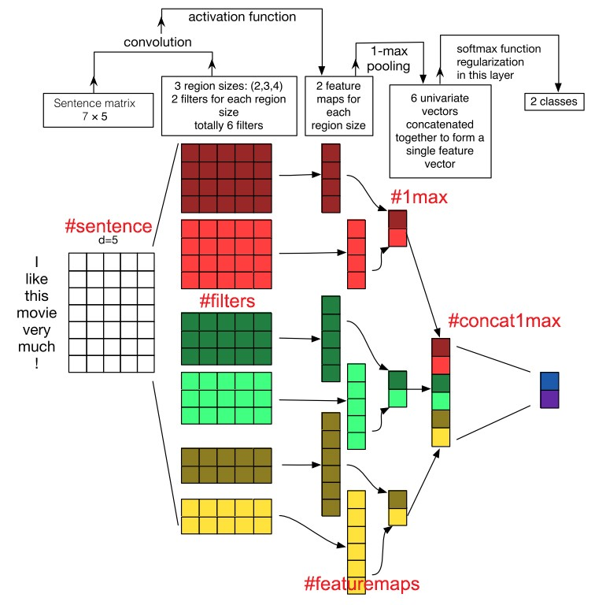
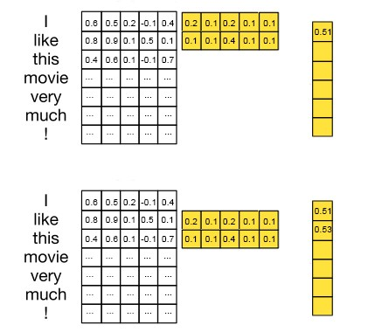
Convolutional Neural Network (CNN)
Text Classification
#featuremaps
Source: https://towardsdatascience.com/understanding-how-convolutional-neural-network-cnn-perform-text-classification-with-word-d2ee64b9dd0b

Slide 54
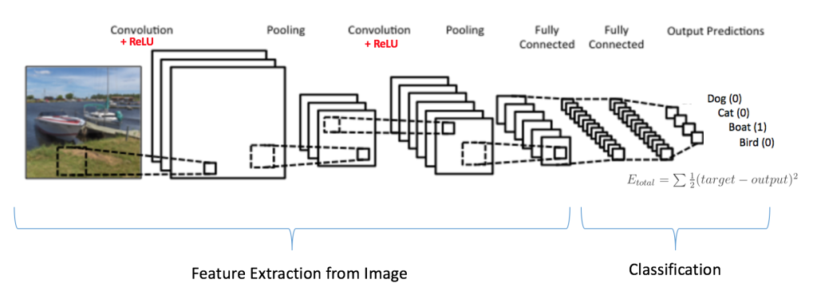
Convolutional Neural Network (CNN)
Image Classification
Source: https://ujjwalkarn.me/2016/08/11/intuitive-explanation-convnets/

Slide 55
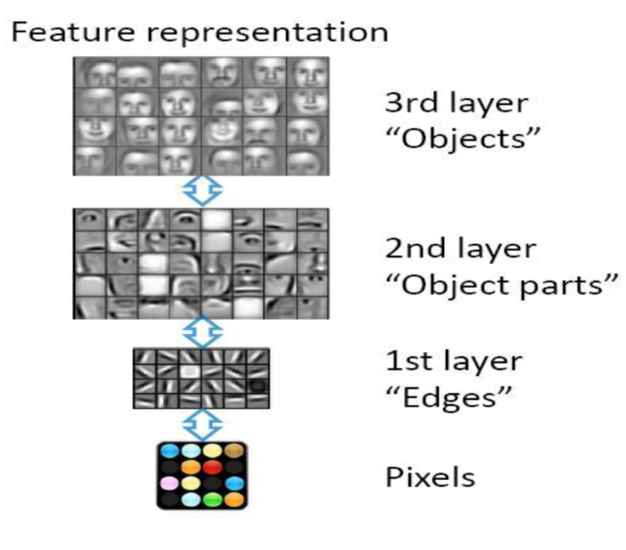

Convolutional Neural Network (CNN)
Image Classification
Source: http://cs231n.github.io/classification/

Slide 56

Convolutional Neural Network (CNN)
Image Classification
Source: https://becominghuman.ai/building-an-image-classifier-using-deep-learning-in-python-totally-from-a-beginners-perspective-be8dbaf22dd8

Slide 57
Applications of CNN
Facial Recognition
Image classifications
Analyzing Documents
Many Other Interesting Fields

Slide 58
References
https://towardsdatascience.com/applied-deep-learning-part-3-autoencoders-1c083af4d798
http://www.wildml.com/2015/12/implementing-a-cnn-for-text-classification-in-tensorflow/
https://towardsdatascience.com/a-walkthrough-of-convolutional-neural-network-7f474f91d7bd

